Slide 1
Computer Organization and Architecture - Performance Analysis.
Shriram K Vasudevan
Session – 16

Slide 2
Introduction
How can someone say that “the CAR A has better economy than CAR B?”. They will have to measure the performance. One should measure, summarize the factors which actually governs the performance. Here, if you take a CAR, its mileage, efficiency, engine capacity, maintenance etc. all help in determining the performance.
A simple example can be Car A gives 30 KMPL whereas CAR B gives 25 KMPL. So, it is obvious with respect to mileage Car A is better.
Now comes the crux. How to measure performance of a computer? One should measure and summarize the key factors which govern the performance of a computer.
The next question to be answered is “Why do we measure performance?” Answer is simple and straight forward. To understand how much effective the system is, one should measure the performance.
More about measuring performance is to be seen in this session.

Slide 3
It is challenging – Let us understand why!
We know very well that computer is not just hardware or software. It is a mix of both.
The moment you have both in picture, complexity comes in as an non-invited guest.
That too, with the amount of features and sophistication the recent systems have, measuring performance is not an easy task. How to measure the performance itself is a research area and the designers really have a tough time in this sector.
One can think about analysing the performance of the system by reading through the existing instruction set details and other technical information pamphlets. It is next to impossible to read through all of these and to assess the performance.
Based on the applications installed, based on the type of application, performance measurement metrics may be different and certainly, it is not an easy task.
Again, measuring the performance while also carefully analysing the limitations would help in selecting the most appropriate computer.

Slide 4
Contd.,
One should not just think that performance is connected to external parameters of a computer. It is much more than that.
Before going any deeper to analyse the performance it is important to understand that what governs the performance of a typical computer.
This discussion is aimed at it and will help the readers in understanding the importance of performance monitoring while also highlighting the measurement criteria.

Slide 5
Let us define performance
When someone looks abstract, the performance could appear simple. But, once digged deeper, it will really be challenging.
Well, the simple question one should try answering now is "How can someone say Computer A is performing better than Computer B?".
We will see an example to understand how and why it challenging to measure the performance.
Let us take two different car manufacturers - A and B.
Metrics for Maker A's and Maker B’s Car are summarized below as a table 1 and 2. (All assumptions)
1. CC - 3000 2. Highest Speed 3. Economy 4. Gears 5. Safety Features 6. Maintenance cost per year | 3000 KMPH 10 KMPL Manual – 6 Gears 2 Airbags + ABS 500 USD
1. CC - 3000 2. Highest Speed 3. Economy 4. Gears 5. Safety Features 6. Maintenance cost per year | 2000 180 KMPH 18 KMPL Manual – 4 Gears No Airbags 100 USD

Slide 6
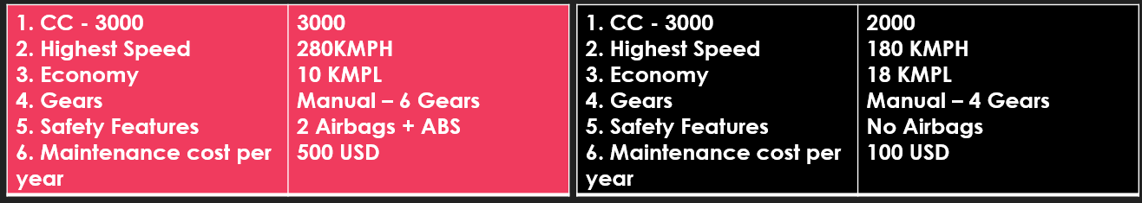


Contd.,
So, let us see which of these two cars is a better performing car.
Car A is better than CAR B when it comes to
Speed
Pickup
Safety Features
Car B is better than CAR A when it comes it
Fuel economy.
Maintenance cost
Now, it could be understood! Performance can’t be blindly measured! Based on what you measure, performance varies!
If you want Virat Kohli to perform for bowling you can’t get the best performance and vice versa with bat for Bumrah!

Slide 7


Contd.,
Assume you have 2 computers (PCs). PC named Sachin and PC named Sehwag.
How do we compare the performance now?
We can say that, whichever PC completes the task first can be regarded as the fastest one. Correct? Here, if Sachin completes the task faster, then, he is the fastest.
Assume there is a group of 11 PCs (11 Players) in a lab. How could performance be measured in this scenario?
Simple, how much work has been done as a team (all PCs together) is the performance measurement criteria here.
Given this example, one should understand that "Performance metrics are different for different conditions".

Slide 8
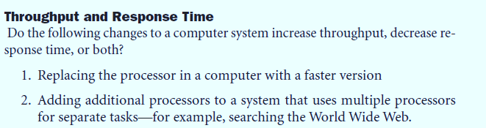
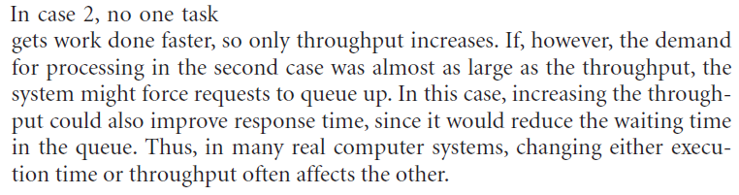
One Question For You !!!

Slide 9
Let us do some math!
An Athlete is running 100 meters in 15 Seconds. With glucose being consumed before race, he covers it by 12 Seconds.
With decrease or reduction in the time consumed to cover the race distance, one can see improved performance.
Relating this to computers, one can say, with the execution time getting reduced, one can maximize the performance.

Slide 10
Contd.,
Performance is generally defined by the formula presented below:
Performance = 1 / Execution Time.
As discussed earlier, when someone has to compare the performance of two diffferent PCs say A and B, the following would be the method.
Assume performance of A is better than B. (Disclaimer : Assume)
A's Performance > B's Performance
1/ A's Execution Time > 1 / B's Execution Time
Execution Time of B > Execution Time of A
Or in other words, Execution Time of A < Execution Time of B.

Slide 11

Contd.,
Instead of saying just Performance of A is greater than performance of B, it would always be better if someone can say it as “A is n times faster than B”. So, ‘n’ is to be found.
To find ‘n’, one can use the following expression:
n = A's Performance / B’s Performance.

Slide 12
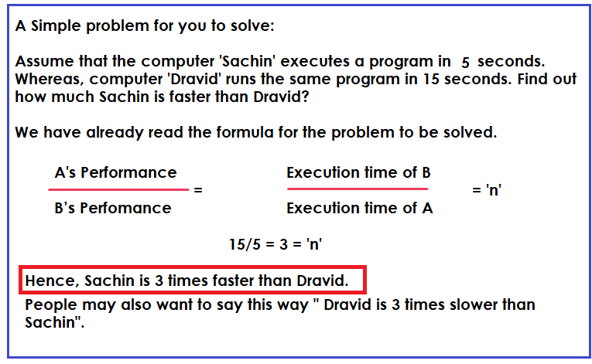
Contd.,

Slide 13
How do we analyse the performance of Embedded Systems?
First, let us answer this question.
What is an “embedded system”?
An embedded system is combination of software + hardware meant to do a dedicated task.
Simple example: Projector, Washing Machine etc.
Now, the target is to measure the performance of the Embedded Systems and it is not as other general purpose systems.
Recollect the term “Real Time”.
Embedded Systems are all expected to perform the task real time. Real time is “Logical correctness of the operation within deterministic deadlines”.
Real time can be hard real time or soft real time.
So, to conclude, for embedded systems, “Meeting the deadlines” is the very important performance measure.
Relate this. If car braking system does not work in time, what will happen?
Rest all performance measures are looked into after looking at the real time behaviour.

Slide 14
Performance Measurement – Let us get better.
Session - 17

Slide 15
Let us understand the definitions, first!
First, let us understand what is CPU execution time. (AKA CPU TIME)
Amount of time, the CPU actually spends on executing a task is referred as “CPU Execution Time”.
CPU could spend time on “the tasks” and “OS” tasks. The tasks given by the user, when CPU spends time for it, it is called, user CPU time. Meanwhile, if spent time for OS tasks, it could be termed “System CPU time”.

Slide 16
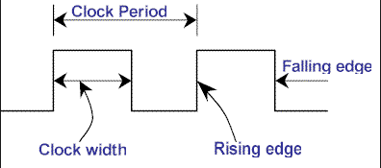
Contd.,
How do you defined the speed of a computer (i.e. CPU)? You could have read it as 4 GHZ, 2 GHZ etc. There is a term for the same. It is called clock cycle. It is the amount of time spent between the two pulses of an oscillator.
Unit of the Clock Cycle is Hz. We are never used the slower processors in the recent days and the unit has not grown to GHz. Typically a 2GHz processor go for 2,00,00,00,000 clock cycles per second. (People call this clock rate)

Slide 17
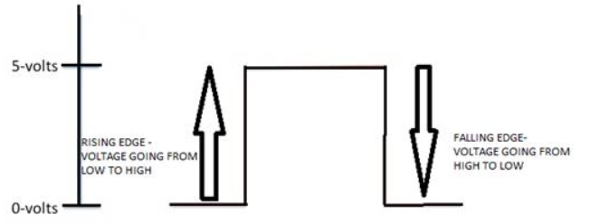
Contd.,
Let us understand Falling edge and Rising edge.
If a circuit gets rising edge triggered, the circuit will become active when its clock signal turns from LOW TO HIGH. This is also referred as “Rising Edge or positive edge”.
Similarly for a falling is referred as high to low transition!

Slide 18
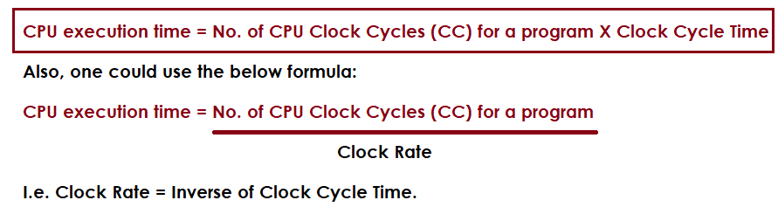
Factors related to CPU performance – Some formulas.
There are so many metrics followed by designers. Let us follow one metric – CPU execution time.
Let us learn some formula:

Slide 19
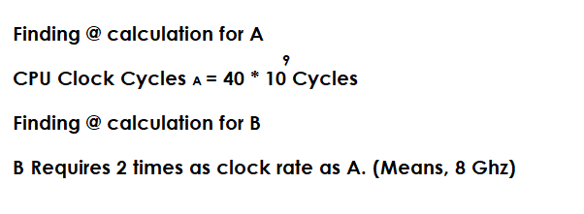
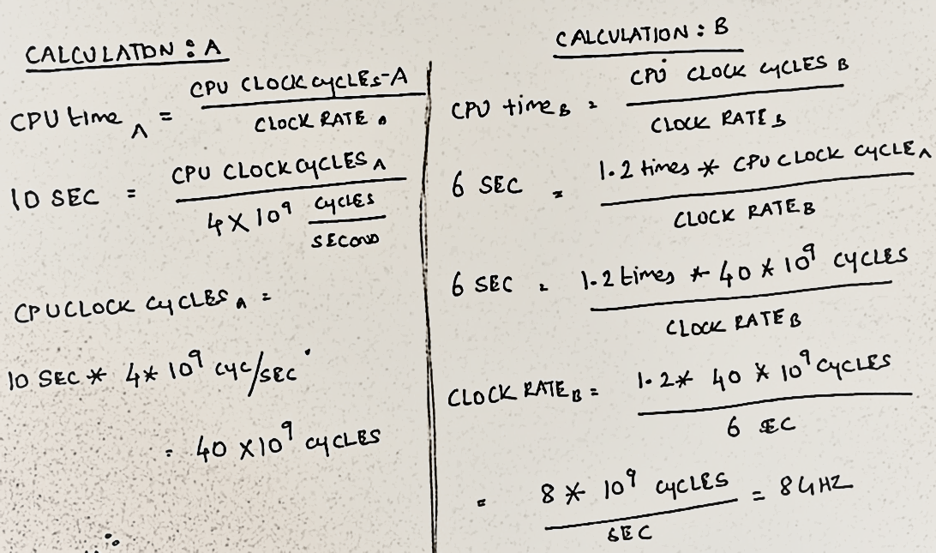
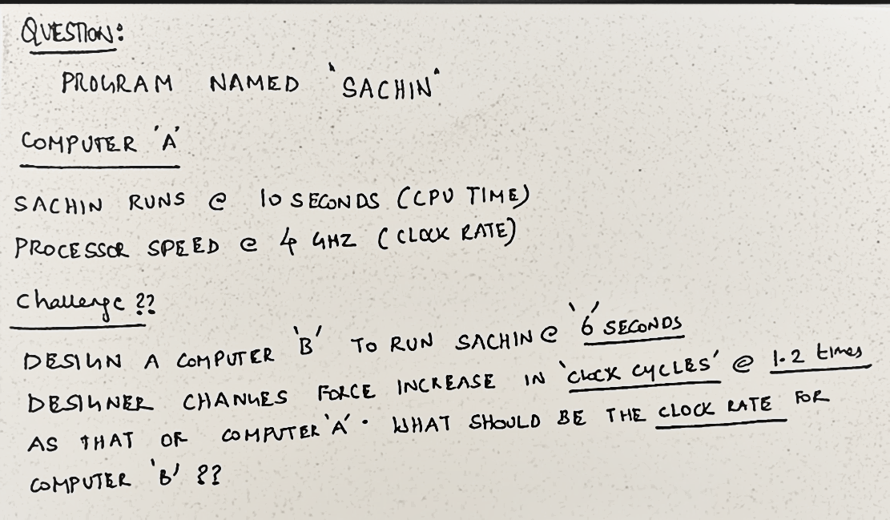
A Problem …

Slide 20
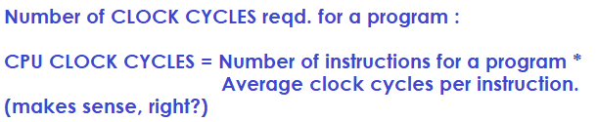
Lets get deeper!
Let me ask a question to you guys. I can read a book with 250 pages in 3 hours. Should it be same as your speed?
I could be faster or slower. Am I right? – Think about it.
This is the point.
Remember this formula, This could be useful.

Slide 21
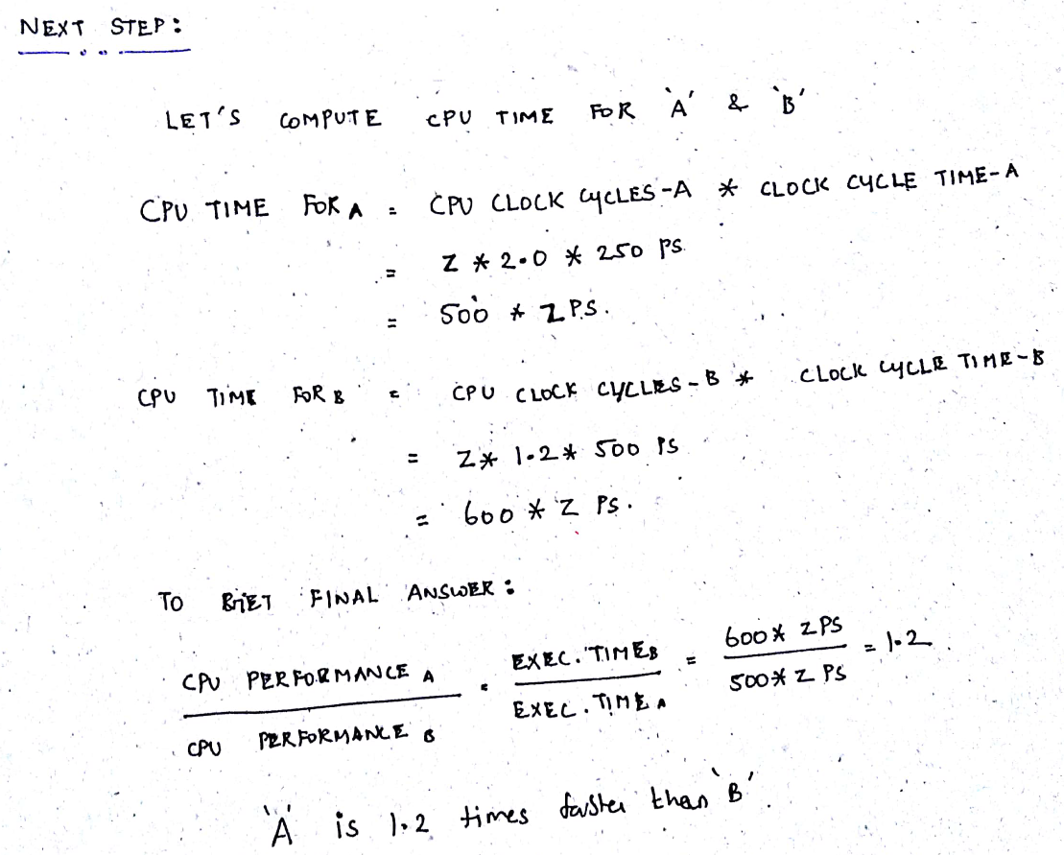
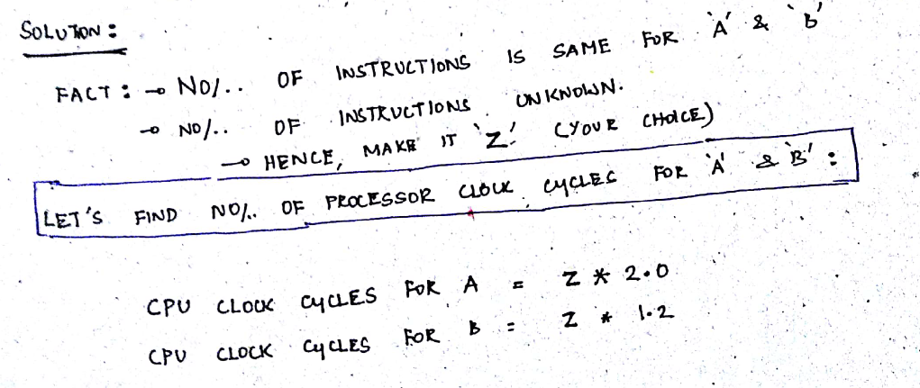
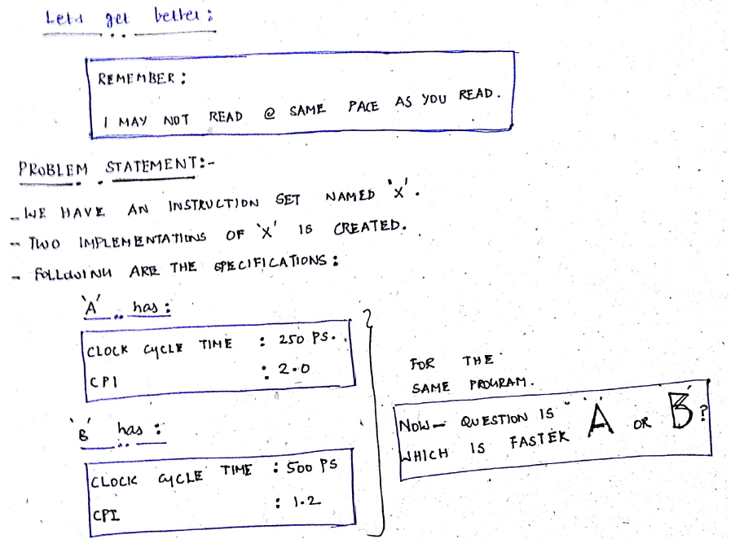
Let’s solve a problem.

Slide 22
Let us get a step better.
CPI = Clock Cycles Per Instruction (Remember this, without fail).
How do we get CPI?. It is possible through simulation of the implementation. Or, one could choose hardware over the simulation to get the details of CPI.

Slide 23
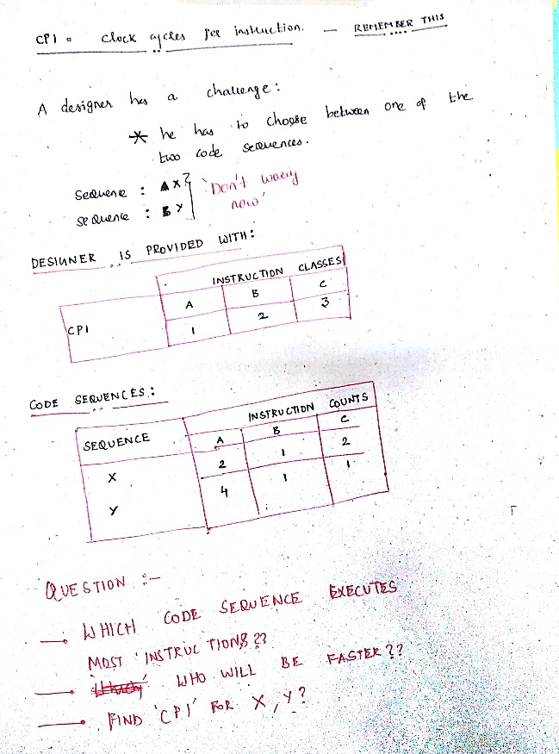
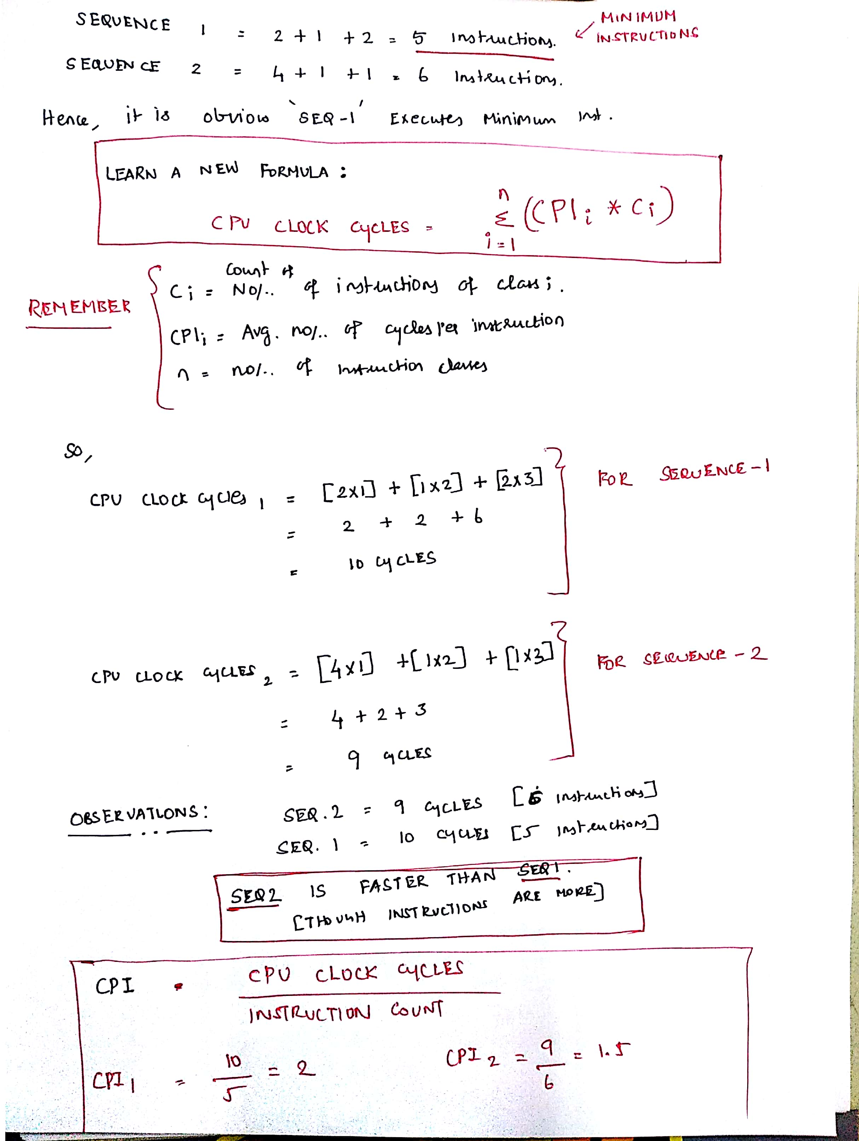
Contd.,

Slide 24
Home work – Solve More Problems with the inputs given
Shriram K Vasudevan

